Slide 1

Lean

Slide 2
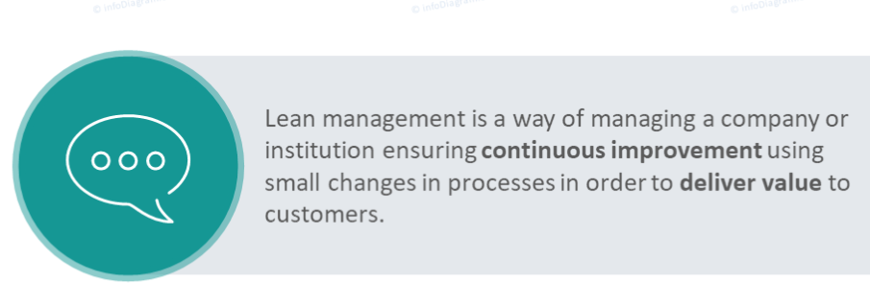
Lean

Slide 3
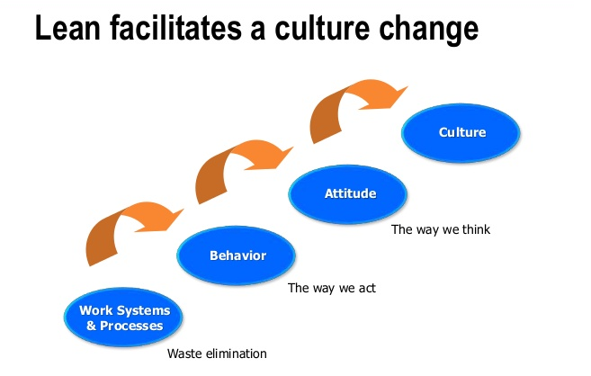
Lean

Slide 4
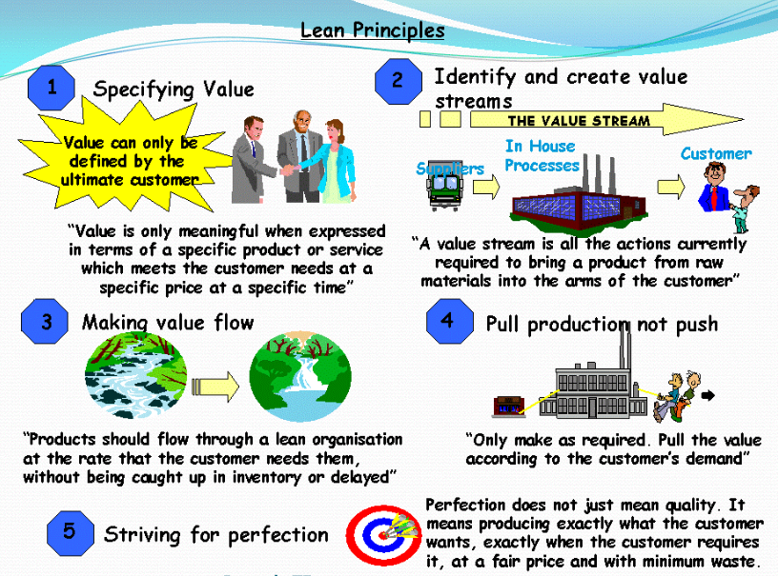
Lean Principles

Slide 5
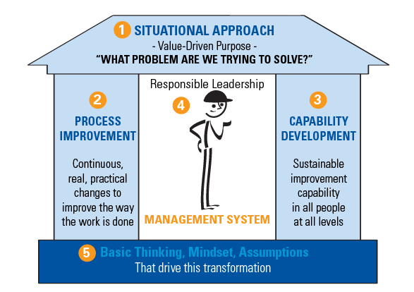
Lean Transformation

Slide 6
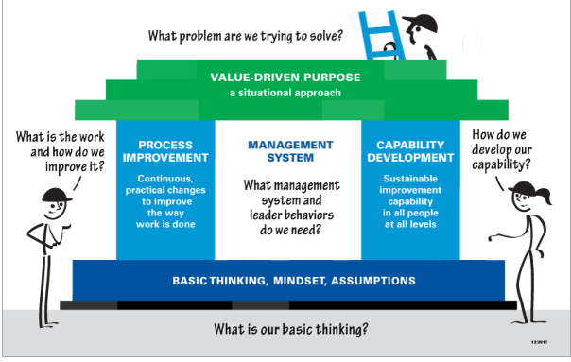
Questions of the Lean Transformation Framework

Slide 7
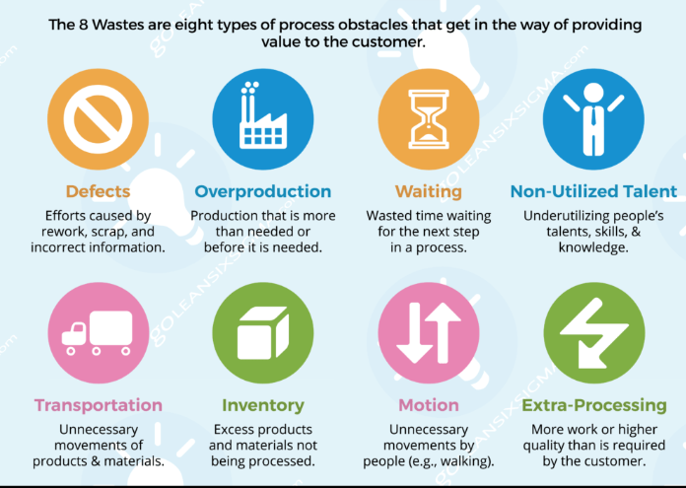
The 8 Wastes-DOWNTIME

Slide 8
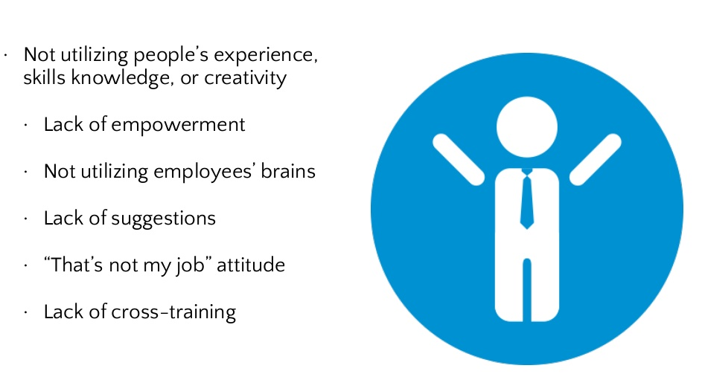
Non-Utilized Talent

Slide 9
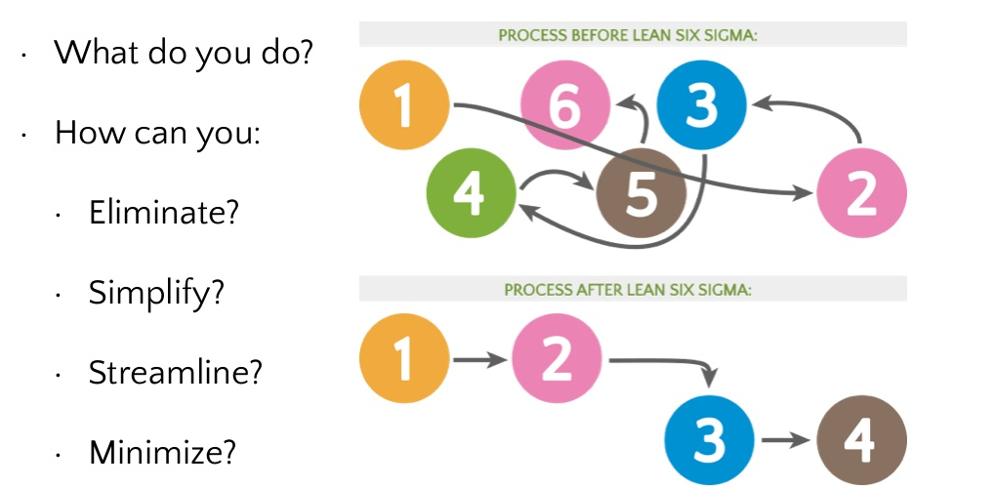
Once Waste is Identified

Slide 10
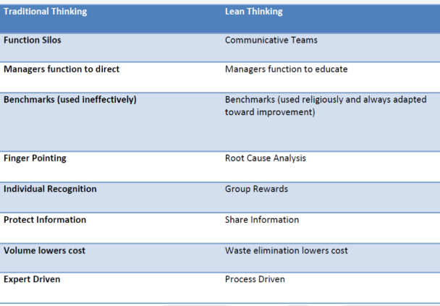
Understanding the Lean Thinking Cultural Shift

Slide 11
Kanban
Limit Work-In-Progress
Visualize the Work
Kanban
Visual Card
Signboard
Just-in-time (JIT)
Measure & Manage Flow

Slide 12
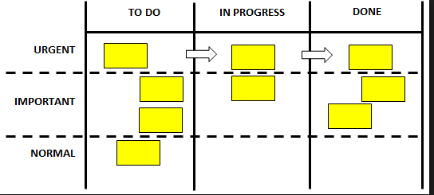
Kanban
Kanban is a Japanese work meaning sign-board.
Three essential components of Kanban
Visual board to represent your work flow (value- stream).
Pull System to work
Work-in progress limit.

Slide 13
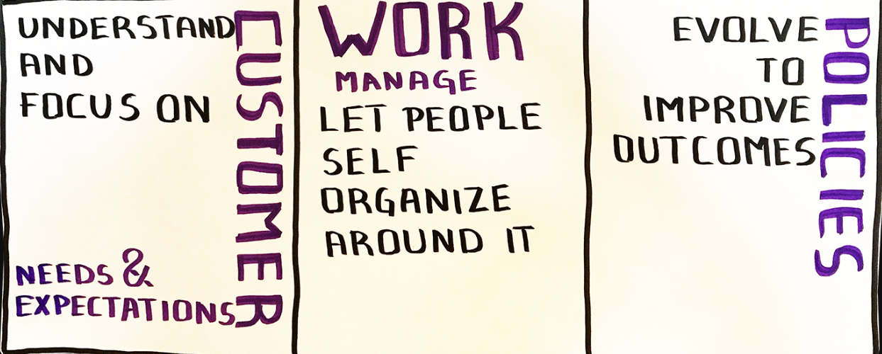
Kanban Service Principles

Slide 14
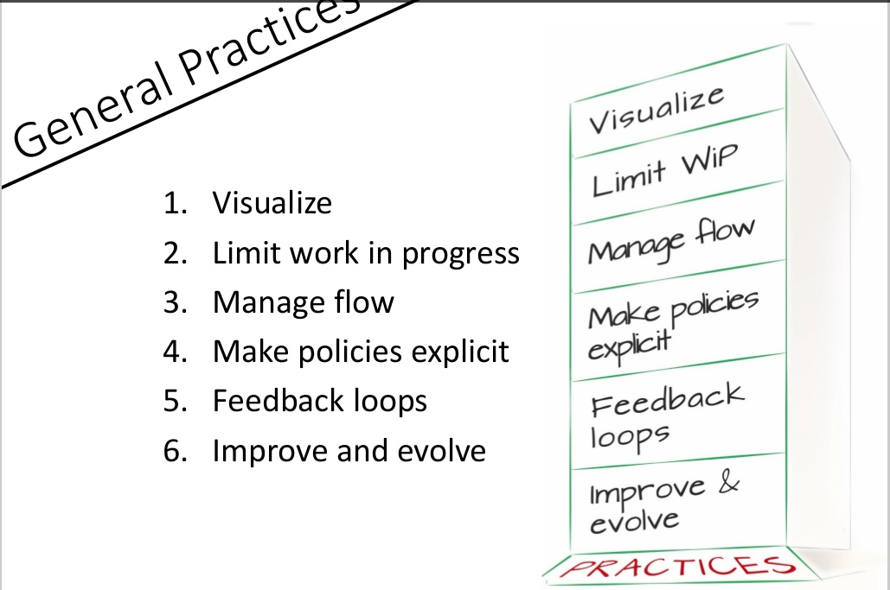
Kanban- Practices

Slide 15
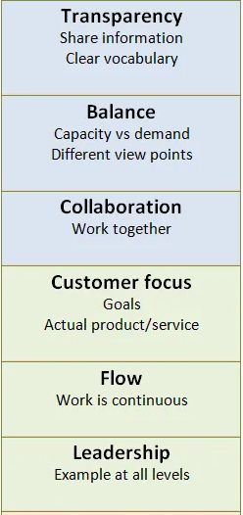
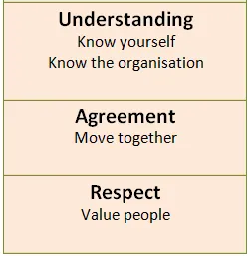
Kanban Value

Slide 16
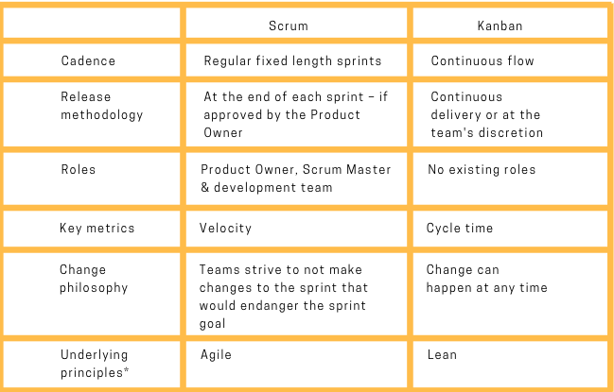
Scrum Vs Kanban

Slide 17
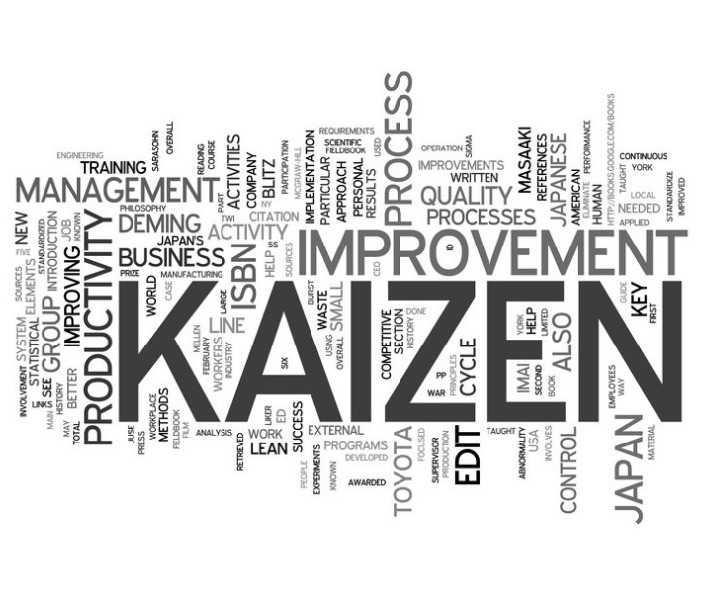
Kaizen

Slide 18
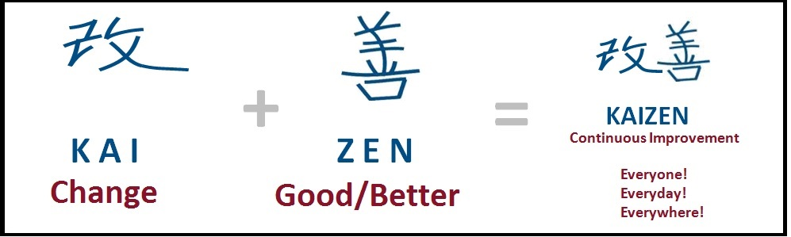
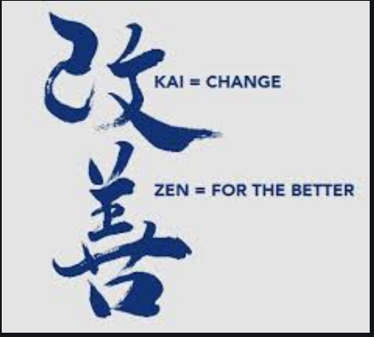
Kaizen

Slide 19
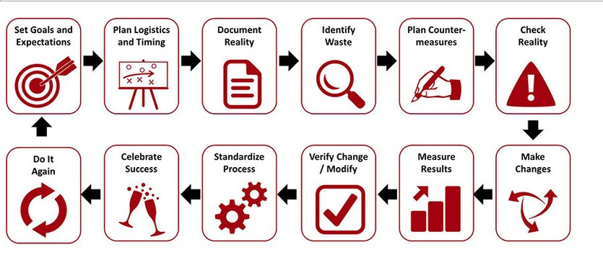
Kaizen Process

Slide 20
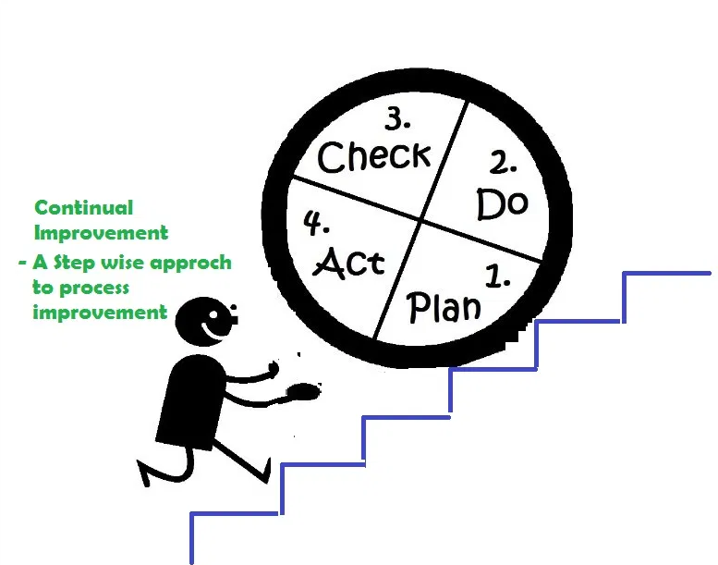
Continous Improvement

Slide 21

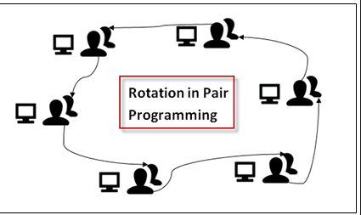
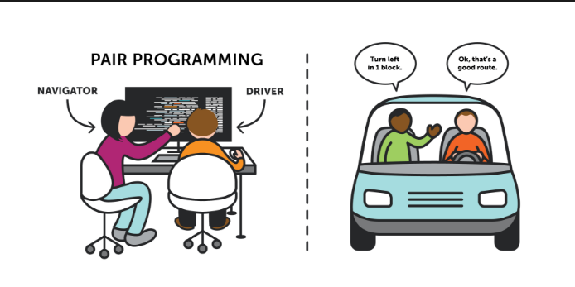
Extreme Programming

Slide 22
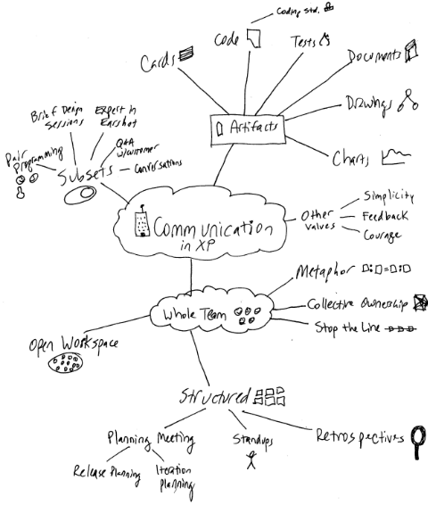
XP- Values Communication

Slide 23
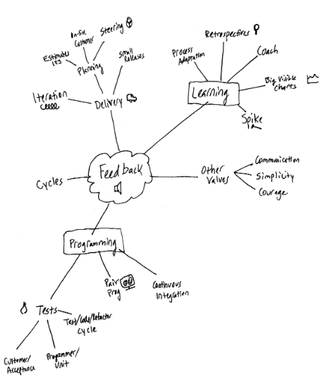
XP- Values Feedback

Slide 24
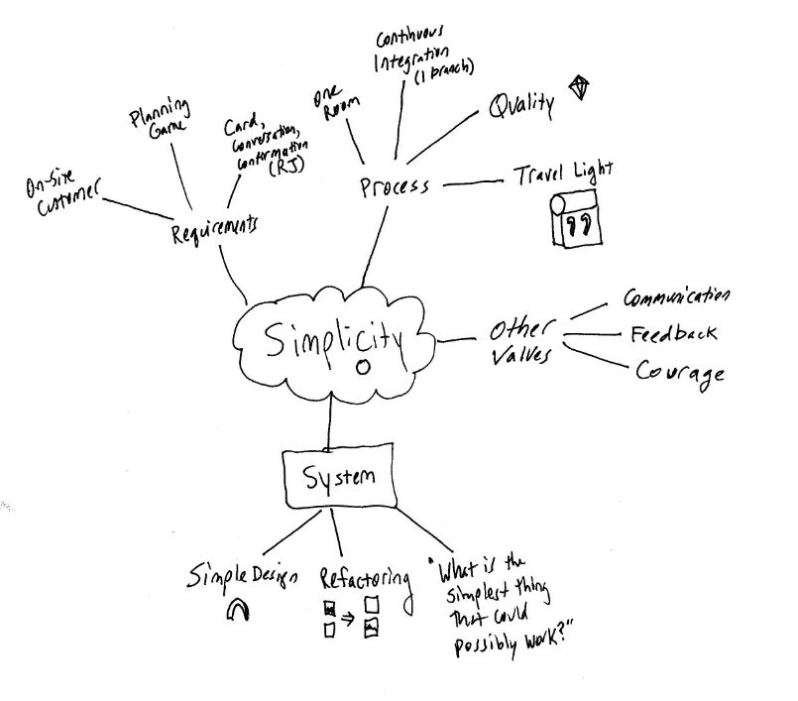
XP- Values Simplicity

Slide 25
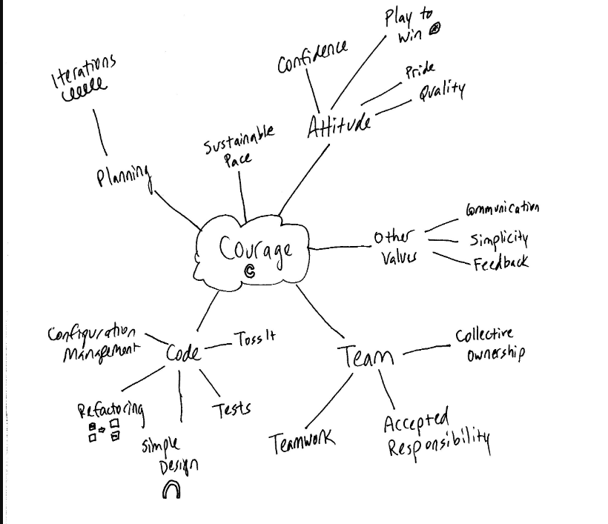
XP- Values Courage

Slide 26
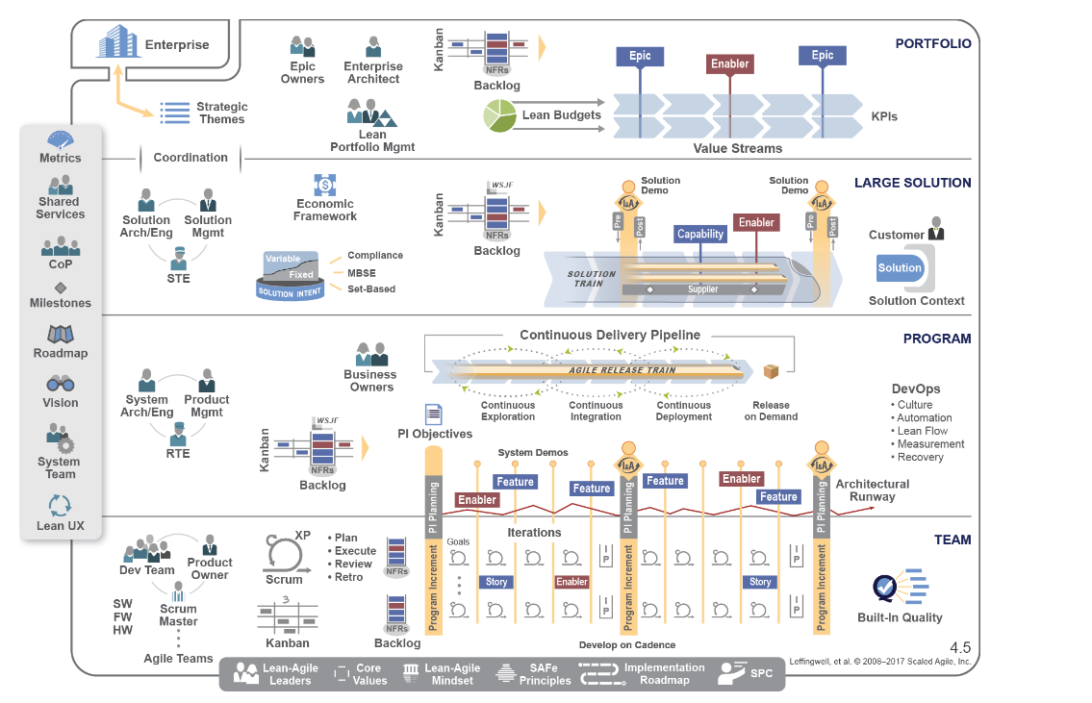
SAFe

Slide 27
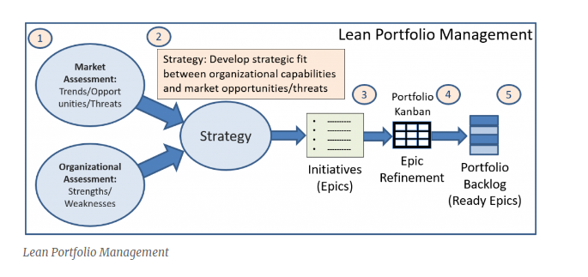
SAFe - Portfolio Level
Strategic Level - Large Program or multiple Programs
Strategy formulation and Investment funding
Program Management and Governance
Value Streams and Agile Release Trains Planning
Centralized Strategy and Decentralized execution
Portfolio vision gives the system an aim
Value Delivery via Business and Architectural Epic

Slide 28
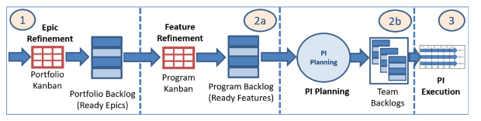
SAFe - Program Level
Agile Release Train for a Value Stream
Virtual organization of 5-12 teams (50 -125 Team members)
Program Increment (PI) for 12 weeks (6 Sprints)
Program Level shared roles for supporting Teams
Self organized and managed team of Agile teams
Continuous Value delivery
Single Program backlog for a common mission
Common cadence and estimation
Value Delivery via features
Key Program Roles
Release Train Engineer is Chief Scrum Master
Program Management owns and prioritize program backlog
System Architect for architecture guidelines
System Team for process and tools for integration
Business Owners are the key stakeholders on Train

Slide 29
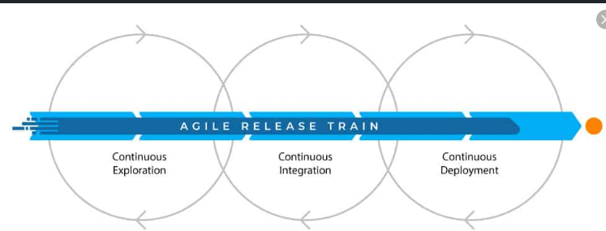
Agile Release Train

Slide 30
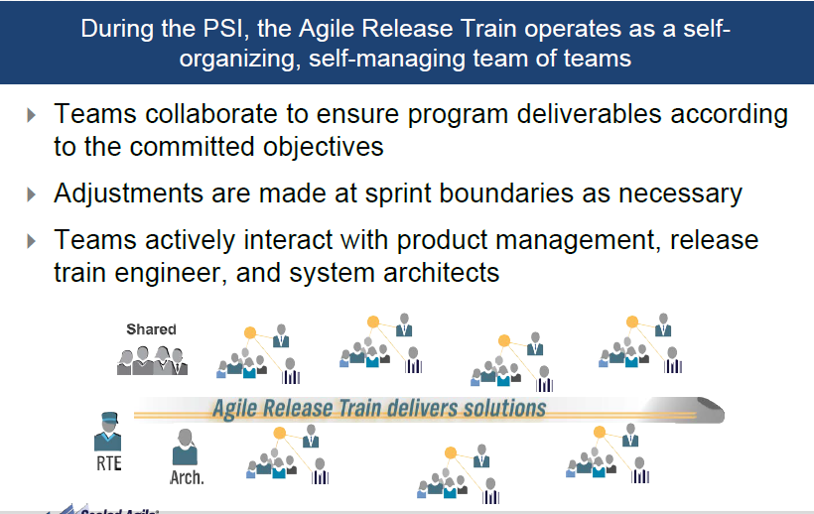
Agile Release Train

Slide 31
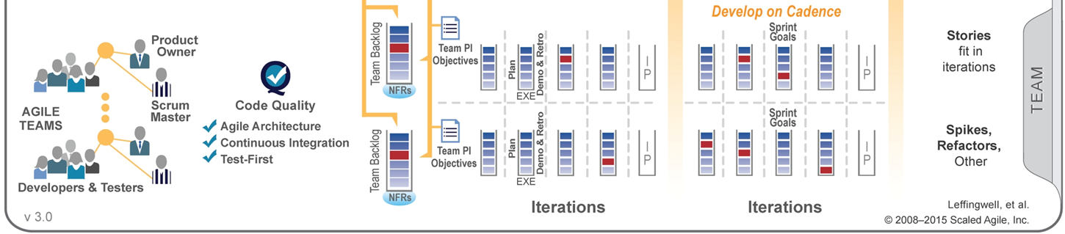
SAFe -Team Level
Teams Operate under program vision, system, architecture and user experience guidance
Value delivery via User Stories
Agile Teams – 7-9 Team members
Scrum Master
Runs the meetings, Remove Impediments, Facilitator to the team
Product Owner
Defines and accepts stories
Acts as customer to the team
Works with Product Management to plan releases
Developer/Testers
Creates and refine user stories
Define/Build/Test/Deliver stories
Commits to PI and Sprint Plans

Slide 32
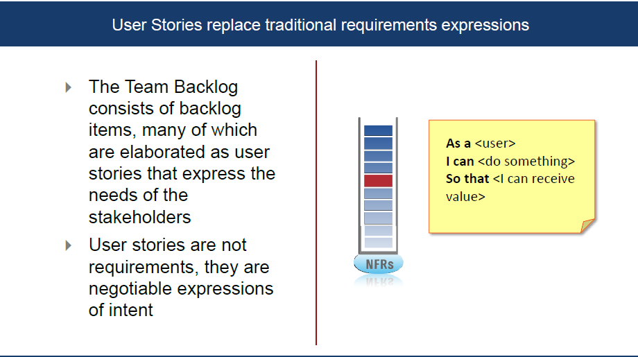
User Story

Slide 33
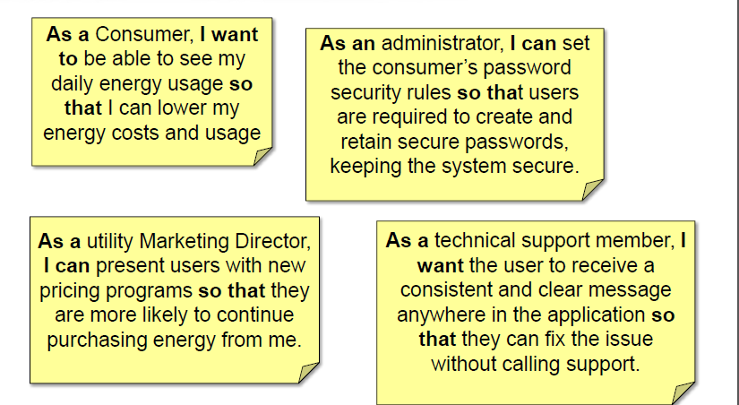
User Story

Slide 34
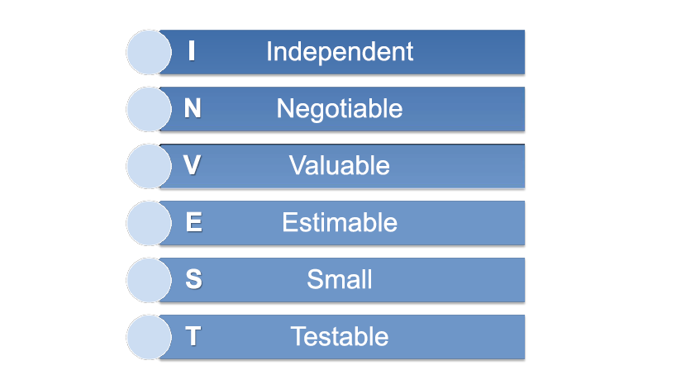
INVEST in a good User Story

Slide 35
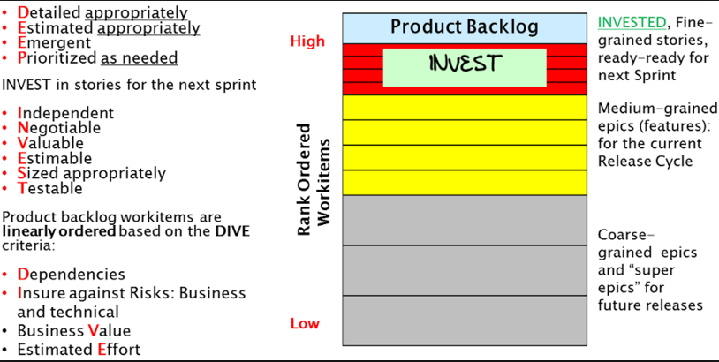
Acronym

Slide 36
DEEP-Product Backlog Items
A product backlog may have several hundred or more work items, hence the acronym DEEP, work items can be comprised of features, defects and test sets (Logical structure of product backlog)
Detailed appropriately: Work items in the backlog are specified at an appropriate level of detail.
Estimate appropriately: work items in the product backlog are estimated appropriately.
Emergent: Product backlog is not frozen or static. It evolves or emerges on an on-going basis in response to product feedback, and changes in competitive, market and business. New backlog items are added, existing items are groomed (revised, refine, elaborated) or deleted or re-prioritized.
Prioritized as needed: Work items in the backlog are linearly rank-ordered as needed.

Slide 37
INVEST -User Stories in next Sprint
Independent of each other : At the specification level stories are independent they offer distinctly different functionality and don’t overlap , Moreover at the implementation level these stories should also be as independent of each other as possible .However , sometimes certain implementation level dependencies may be unavoidable.
Negotiable: Stories in the next sprint are always subject to negotiations and clarifications among product owner (business proxy) and the members of agile development team.
Valuable: Every story for the next sprint offers clear value or benefit to either external user or to customer (outside the development team), or to the team itself or to the stakeholder. For most products and projects, most stories offer value to external users or to customers.
Estimable : From the specification of the User Story itself , an agile team should be able to estimate the efforts needed to implement the user story , this size is in relative size terms ( story point) , and optionally , it can also be in time units ( such as Idle staff- hours or staff-days for the whole team ) .
Sized Appropriately: A simpler interpretation of this criterion is that each story is small enough to be completed and delivered in a single sprint.
Testable: Each story specification is very clear to be able to develop all test cases from its acceptance criteria.

Slide 38
SMART-Tasks
Stories may be broken down into implementation tasks, such as Analysis, Design, Code Development, Unit Testing, Test Case development, on-line help etc. These tasks need to be SMART
SMART Tasks
Specific | We drill down requirements from higher-level overview to the necessary details to understand the global picture.
Measurable | We define precise plans with indicators that allows to verify that ' We say what we do, and we do what we say'.
Achievable | We break down our analysis in number of objectives that we are sure to meet, and we can commit on.
Realistic | We focus on most important aspect of your needs first and propose our requirement based on findings.
Timely | We deliver clean project/ activity plans that we will follow and communicate on to achieve objectives.

Slide 39
DIVE the product backlog
Product backlog items should be linearly ordered based on the DIVE criteria, which requires careful consideration of all four factors captured in the DIVE acronym.
Dependencies: Even after minimizing the dependencies among stories or epic (which is always a good thing to do) there may still be few unavoidable dependencies and they will have an impact on rank ordering. If work item A depends on work item B, B needs to be rank- ordered higher than A.
Insure against Risks: Business as well as technical risk.
Business Value:
Estimated Efforts

Slide 40
Velocity
Velocity is a measure of a team’s rate of progress used to estimate future commitments/capacity.
It is measured by summing the number of story points ‘DONE’ in an Iteration.
Factors affecting Team Velocity
Number of members
Unresolved Impediments
Unclear acceptance Criteria
Shifting Priorities
Interruptions
Multi- tasking
Skill level
New Members
Vacation/ Sick time

Slide 41
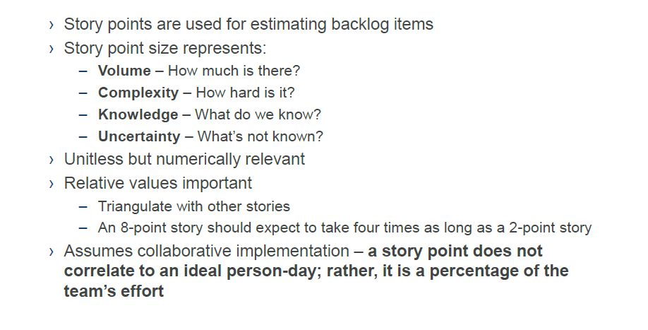
Relative Sizing with Story Points

Slide 42
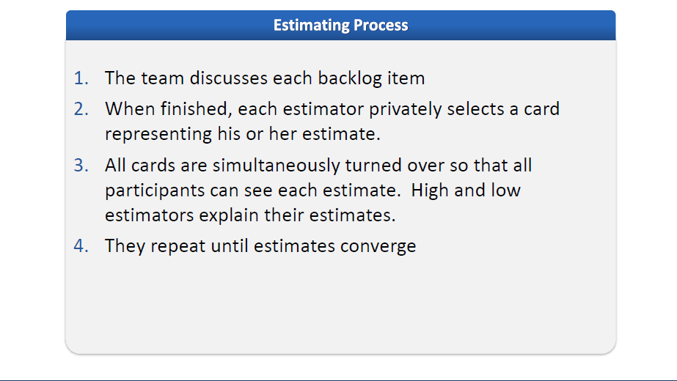
Estimation – Poker Method

Slide 43
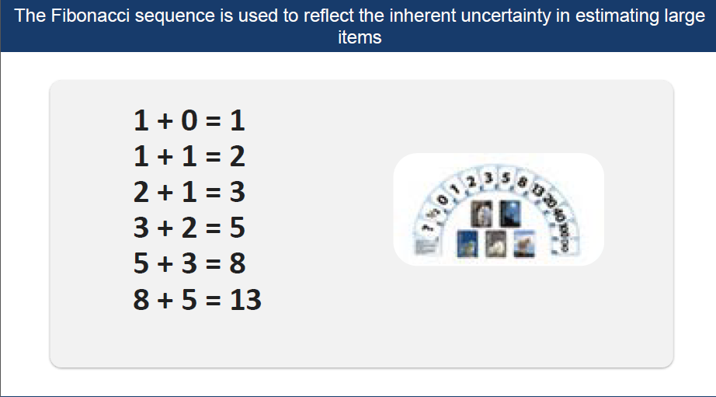
Fibonacci Sequence

Slide 44
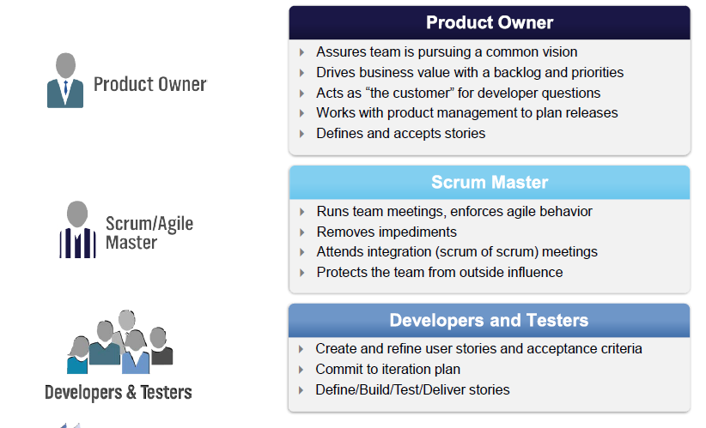
Roles in Scrum

Slide 45
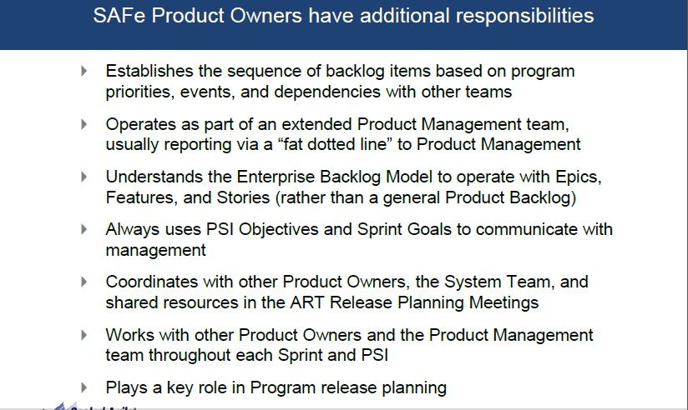
Product owner in Enterprise

Slide 46
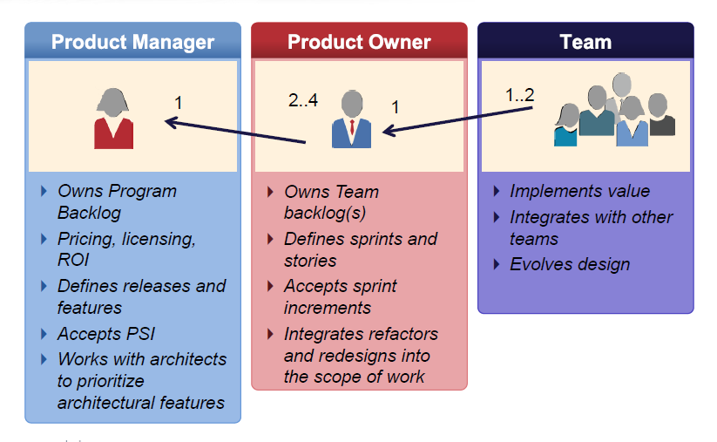
Release Governance

Slide 47
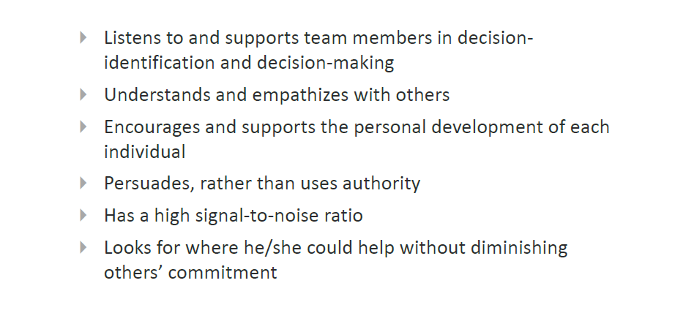
Scrum Master as Servant Leader

Slide 48
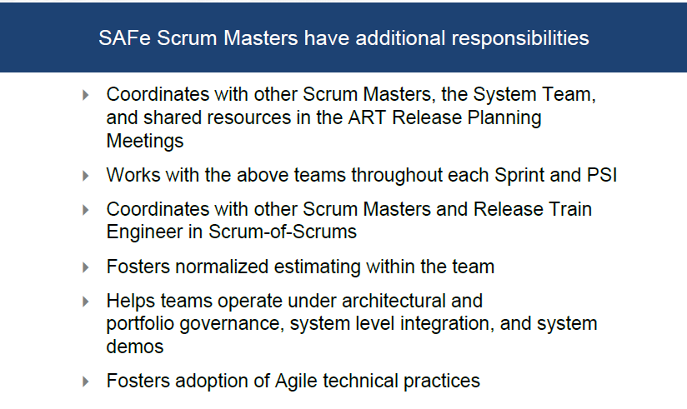
Scrum Master in the Enterprise

Slide 49
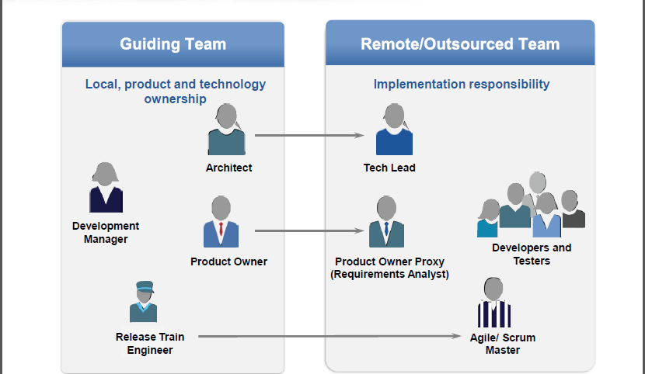
Distributed Team

Slide 50
Key Ceremonies
Release Planning
Two days in each PI (12 weeks)
Everyone attends with result of program objective for the next SPI
Sprint Planning
Team commitment for a sprint – Sprint Backlog
Daily Scrum and Scrum of Scrum
Daily stand up meeting
Sprint Demo
Team sprint demo to key stakeholders
Sprint Retrospective
Team reflects on how to become more effective and adjust

Slide 51
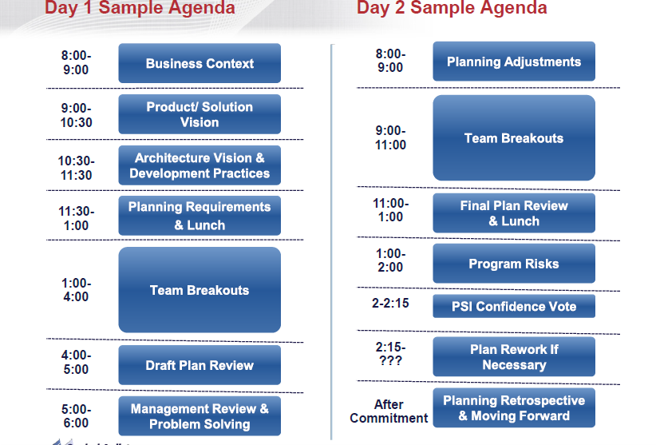
Release Planning

Slide 52
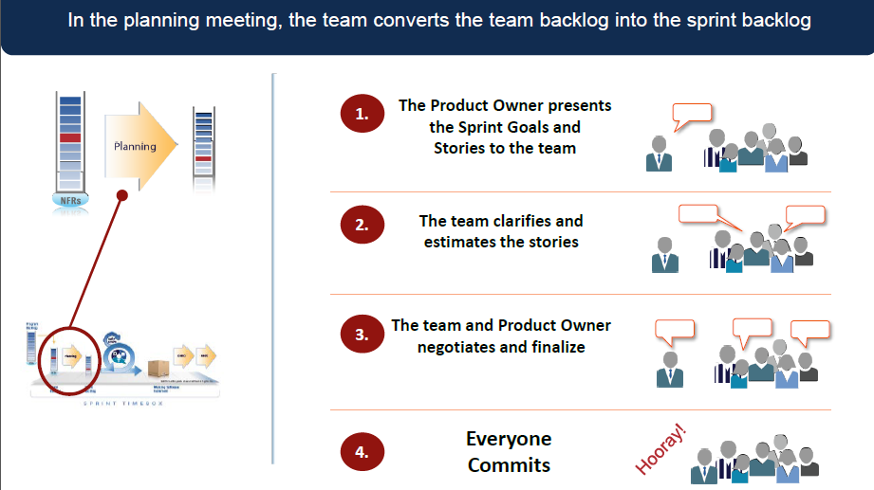
Sprint Planning

Slide 53
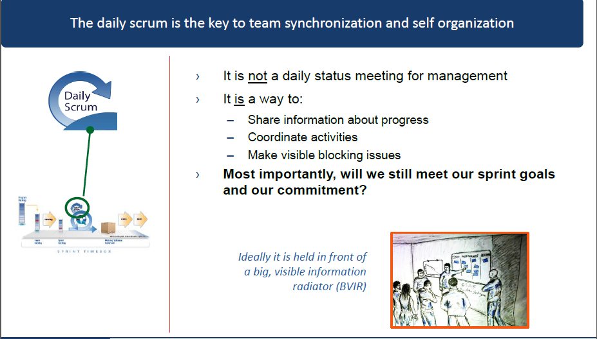
Daily Standup

Slide 54
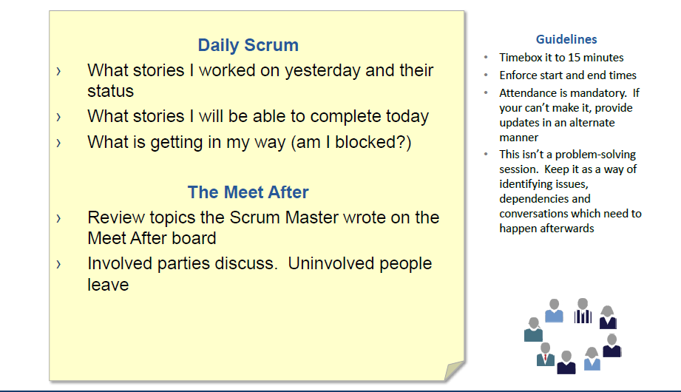
Daily Standup

Slide 55
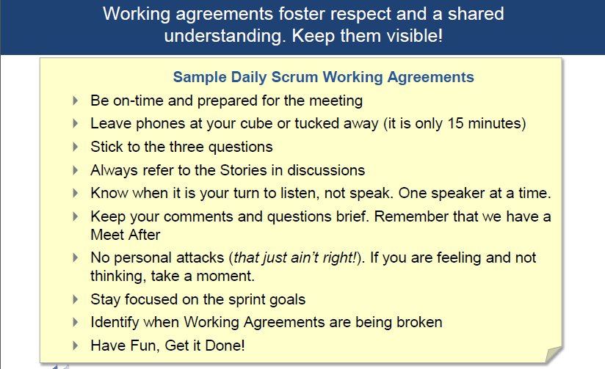
Working Agreements- Daily Standup

Slide 56

Mid Sprint Event

Slide 57

Mid Sprint Review

Slide 58

Backlog Refinement

Slide 59

Sprint Demo

Slide 60

Retrospective Meeting

Slide 61

SOS

Slide 62

Interactions- multiple agile teams

Slide 63

System Demo

Slide 64

Dev ops

Slide 65

HIP

Slide 66

Develop On Cadence. Deliver on Demand

Slide 67

SAFe Delivers Business Results

Slide 68


Q&A

